Slide 1
The Future of JBoss
Dr Mark Little

Slide 2
Overview
Where are we today and why?
Mobile and Cloud
  Ubiquitous computing in the large
Hardware and software forces in action
Let’s avoid reinventing the wheel yet again
What does this mean for today’s middleware offerings?
JBoss plans

Slide 3
The times have changed
There are already more mobile devices than computers
There are 4x more processors on the planet than people
  Most have TCP stacks
    dsPIC33FJ12GP 16-bit microcontroller has as much horsepower as a VAX (40MIPs), can handle 16+ sensors, and is 1/8 the size of a penny
  20 million iPads already
    1 in 2 Americans predicated to have smart phones by the end of 2011 compared to 1 in 10 in 2008

Slide 4


The times have changed

Slide 5
Thin or fat clients?
Thin clients have certain advantages
  Easier to manage, less to go wrong
  More scalable architectures
Rich clients have certain advantages
  Your data is where you need it, when you need it
  Able to execute a wider range of applications
Thin clients are typically the domain of constrained devices

Slide 6
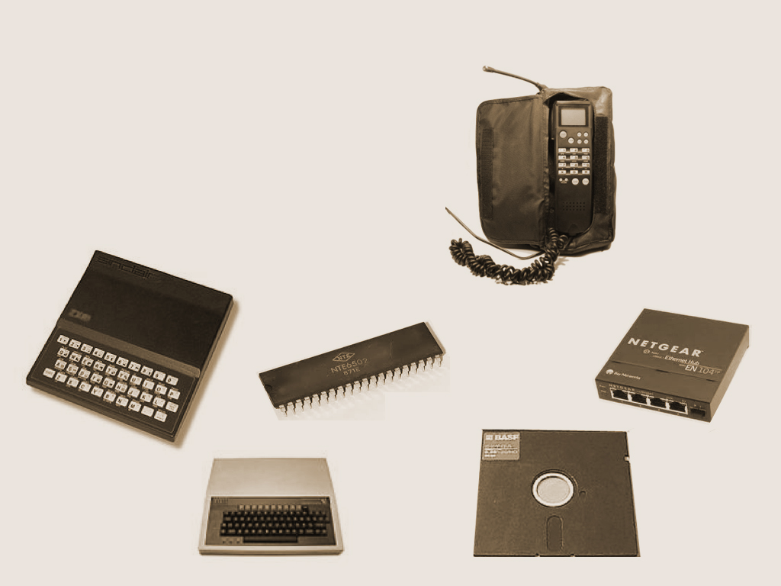
30 years ago…
Notes:
To look at the future for Jboss let's look at what's brought us to this point in the 21st century.
These devices and technologies are only 30 years old and back then they were considered cutting edge. Today most engineers wouldn't consider it possible to build anything to run in 32K of memory!

Slide 7
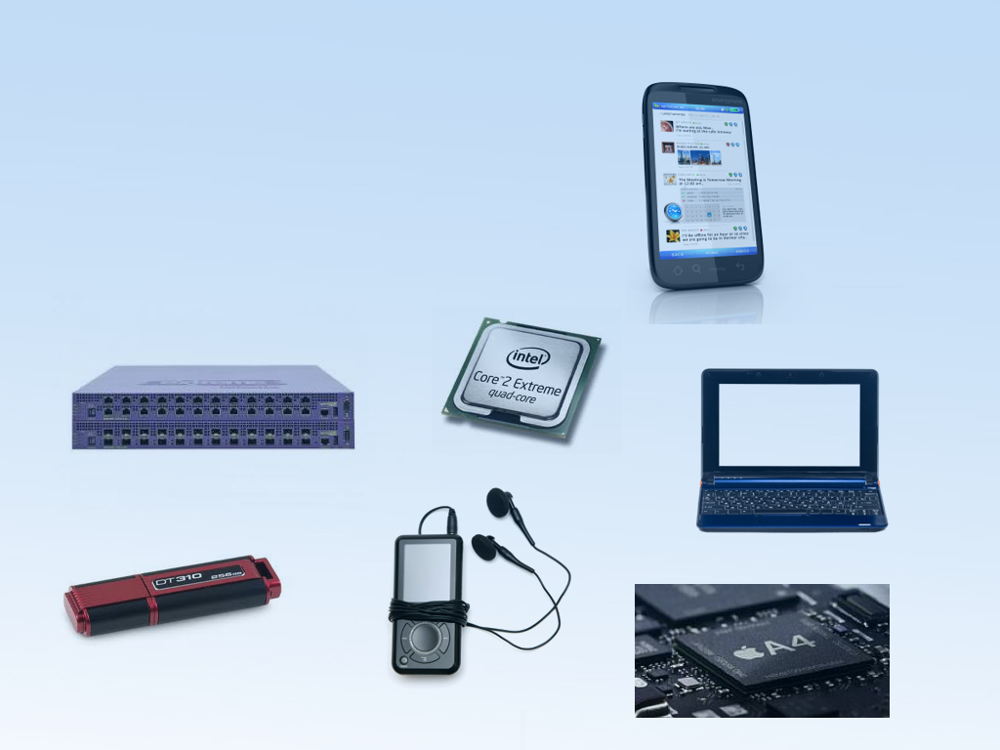
Today…
Notes:
Todays “constrained devices” are more powerful than super computers of only decades earlier.
There are 4x more processors on the planet than people
Most have TCP stacks
dsPIC33FJ12GP 16-bit microcontroller has as much horsepower as a VAX (40MIPs), can handle 16+ sensors, and is 1/8 the size of a penny

Slide 8
So what does this mean?
Middleware is needed whatever the deployment environment
  Mainframes, servers, laptops etc.
Don’t tie the definition of middleware to an implementation
  “Middleware is that s/w which sits between the OS and the application.”
Mobile and Cloud are not new silos for developers!
Enterprise requirements transcend deployment realities

Slide 9
Laptops and Linux and Java. Oh my!
The laptop concept originally devised for children
Now laptops replace desktop
Arguably Java and Linux helped to popularise middleware
But Java is not cool any more
  Ruby, Scala, Erlang, JavaScript, …
Coolness is iPhones, Androids, HTML5, …
Those are the new frontiers of application development

Slide 10
“Non-middleware” devices
Basic word processors on PCs
  Publisher-quality implementations now on laptops
Basic doc readers on smart phones
Games pushing the envelope from Pong through Space Invaders to CoD
  MVCC
  Distributed systems
  Grids
    PSP, Nintendo
Mobile devices contain more and more personal data
  Wallets via NFC
  Documents, photos, etc.

Slide 11
Application requirements
Types of applications increasing in complexity
  Online purchases
  Distributed peer-to-peer interactions
Enterprise requirements becoming a necessity
  Security and identity
  High performance, low latency, reliable messaging
  Database updates with transactions
  Workflows as inter-app interactions increase

Slide 12
What about Cloud?
Public Clouds important
Private Clouds probably more important
  Security and data consistency implications
But Ubiquitous Cloud may become a reality
  Many devices are predicted to have processors/sensors in the future
    It will be cheaper to give them “high end”/off-the-shelf processors/memory than bespoke dye-factories
  In the next few years your light bulb or washing machine may be as powerful and capable as your laptop today

Slide 13
Revolution or evolution?
Many existing applications want to be cloud-enabled
Should not require reimplementing existing infrastructual investments
The industry has spent 40+ years designing enterprise infrastructures
  Many of them work well!
However, middleware today is often not designed for Cloud
  Large scale
  Autonomous
But things are common, or similar enough
  Security
  Transactions
But new capabilities and approaches are required
  Much 80s and 90s research is now applicable

Slide 14

Mobile and Cloud
≠
Developer Silos
Notes:
At JBoss we're going to enable these areas because it is also key to the success of cloud. We need lightweight/embeddable solutions. Simplifications to development frameworks, such as those we've pioneered through CDI and EE6, as well as JPA/NoSQL and even Cloud-TM. And standards based!
This is about laying the foundations for the next generation of cloud computing (really ubiquitous computing!)
Break down developer silos and allow people to use middleware wherever it is needed and not just on servers.

Slide 15

Enterprise Requirements
>
Deployment Realities
Notes:
We must make out projects and platforms available to a wider community if ubiquitous computing is to work today and not in 10 years time.
Enterprise requirements, whether cloud, mobile or servers, are fundamental to a range of applications. In fact in some environments they are even more critical, e.g., security and fault tolerance for public cloud!
JBossTS on mobile for e-commerce.

Slide 16
JBoss for tomorrow!
Stop designing just for today or yesterday
Flexible
  Different environments (not all Java)
  Different component implementations
Adaptable
  Dynamic and static
  Applications could migrate between environments
Reliable, Securable, Available, Scalable

Slide 17
Open source
Open source makes middleware available to everyone
Open source has many of the technologies to help developers on a range of platforms
  HornetQ, Infinispan, Camel, RESTeasy, Seam, …
This is more like building a new jigsaw puzzle from the same pieces
  And incorporating existing completed jigsaws!
We need to facilitate approaches that build on what we have already

Slide 18
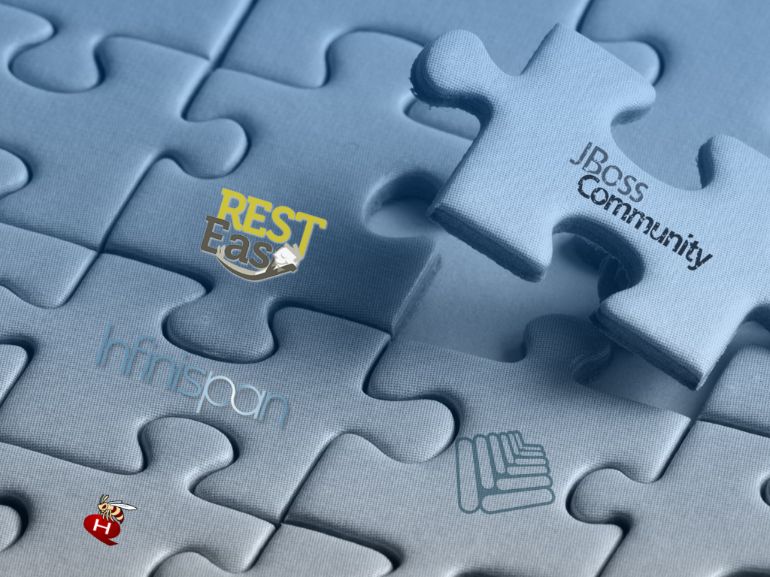
The open source approach to middleware
Notes:
We believe in evolution not revolution. Unlike some vendors, we're not going to tell you that you need to throw out your existing infrastructural investments.
This is like making a new jigsaw out of existing pieces, though of course we may need some new pieces or modify existing pieces.
The aim is to provide platforms and projects that can span all deployment environments.
Open source is important and Jboss is critical to this. AS7/MSC, RESTeasy, … Highly embeddable and lightweight.

Slide 19
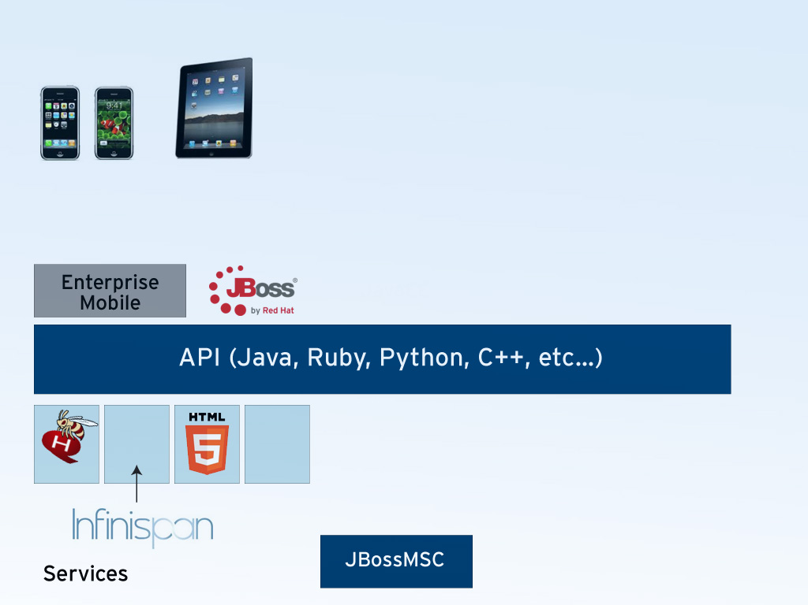

Notes:
PART 1 OF 4. ADVANCE SLIDE TO BUILD.
As an industry we need to stop designing just for today or yesterday
At Jboss we've been doing that for a few years! You only have to look at some of the many projects we've got that are moving beyond just enterprise servers, such as Errai, Drools, Netty and JBossForge!
This is Jboss Everywhere. Let's think about where we might go.
What we want is a solution that spans deployments. API may be language stubs to existing projects.
It'll be built on the MSC, with it's SOA-like approach to services and dynamic behaviours.

Slide 20
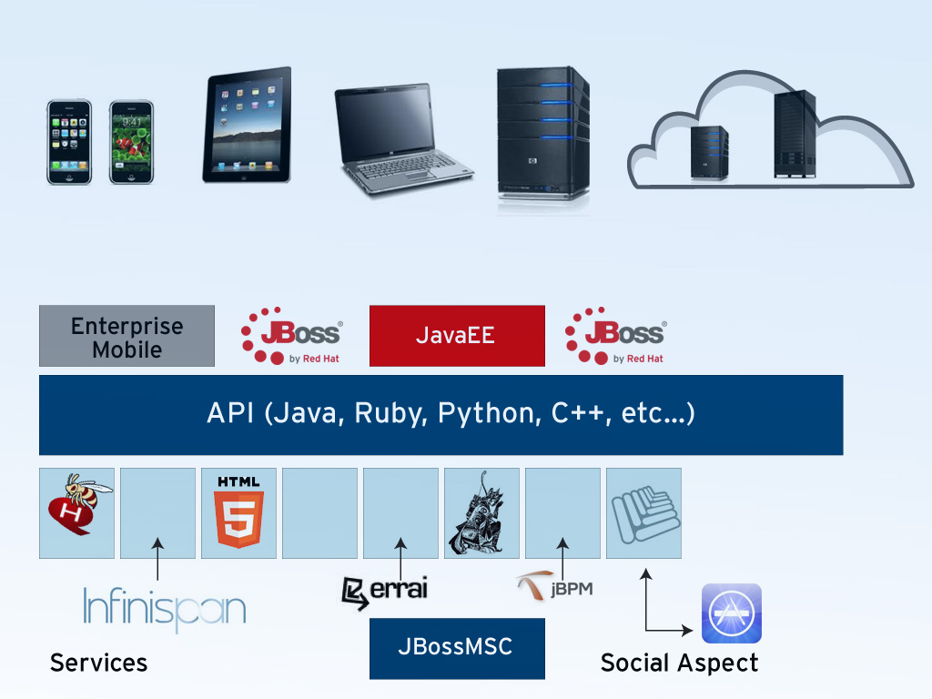
Notes:
PART 2 OF 4. ADVANCE SLIDE TO BUILD.
Then we deploy onto servers and laptops, where the full JavaEE “profile” is needed and more services are added dynamically.
No different to today, except perhaps we need some social aspect to service solution, like an App Store with recommendations. These may be human based or come from monitoring/management that indicates levels of availability, reliability or performance of each component service.

Slide 21
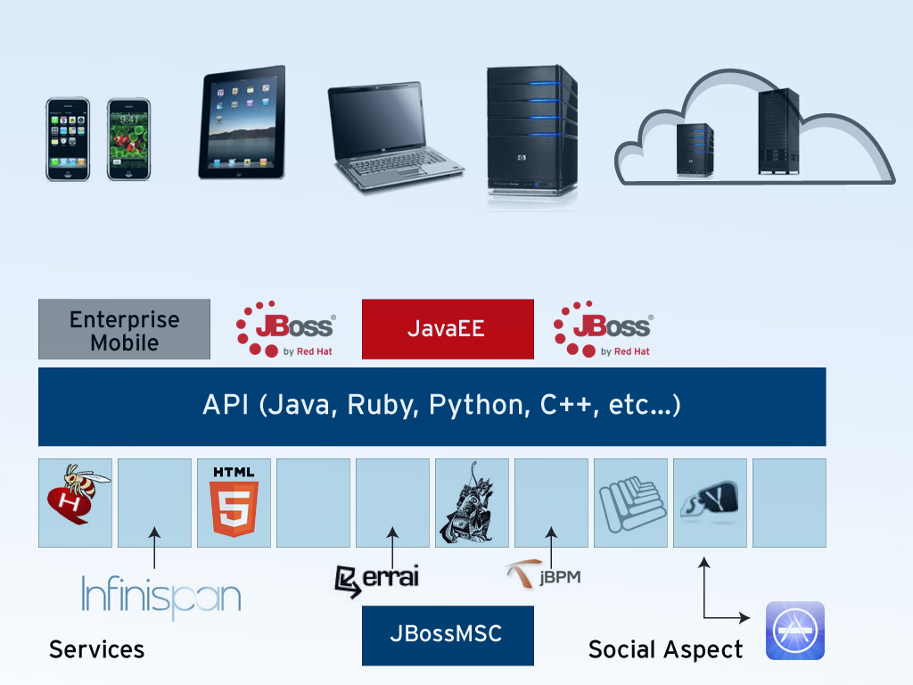
Notes:
PART 3 OF 4. ADVANCE SLIDE TO BUILD.
As we move into the Cloud, we'll need more capabilities such as an ESB to bridge between heterogeneous environments.
SOA is the right approach for developing on the Cloud since it encourages separation of concerns and loose coupling.

Slide 22

Notes:
PART 4 OF 4. ADVANCE SLIDE TO BUILD.
Flexible
Different environments (not all Java)
Cannot assume a single stack
Or that users will want the full stack from any single vendor
Mix-n-match
Adaptable/Autonomous - critical
Dynamic and static
Applications could migrate between environments
Reliable
Securable
All projects are available on all environments. Not different frameworks/middleware per environment!
NOTE: NEXT SLIDE IS SEGUE TO BURR FOR DEMO

Slide 23
Conclusions
Cloud will increase and evolve
Mobile is going to impact far more people than Cloud
Enterprise middleware applications aren’t going away
JBoss components should be available to all developers
The next decade will be defined by the mobile generation

